Slide 1
CSE 3100: Systems Programming
Lecture 1: Course Introduction
Professor Kaleel Mahmood
Department of Computer Science and Engineering
University of Connecticut

Slide 2

CSE 3100: Systems Programming
Introduction to system-level programming with an emphasis on C programming.
We will also focus on process management, and small scale concurrency with multi-threaded programming.
Special attention will be devoted to proficiency with memory management and debugging facilities both in a sequential and parallel setting.
Most of the class right now:

Slide 3


The Money Making Computer Problem
Imagine you work for Apple. They have a computer program that does some computation in native Python code.
Every time the computation completes you get 1 cent. Currently the program takes 1 hour to run. So you get 1 cent per hour.
You want to get rich fast. How can you make the computer program run faster?

Slide 4
Basic ideas to make the program run faster:
Switch the language to C. In many cases C is the faster language to work with*.
Use a faster computer!
Every year computers get faster. So every year you should be able to make more money off the program right?

Slide 5
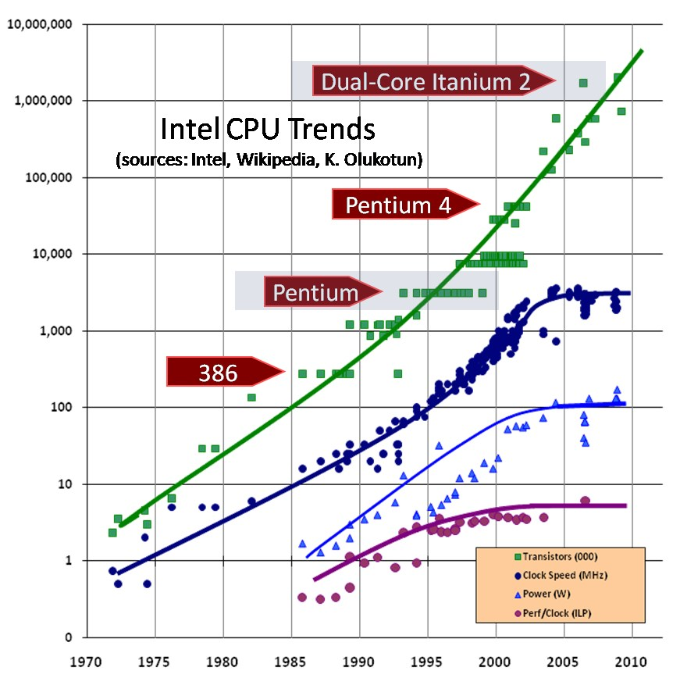

But what happens when you can’t go faster?
Computer Scientist when they see clock speed can’t get faster

Slide 6
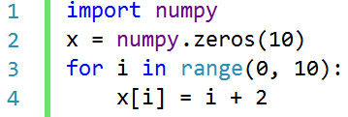
Parallelism
0
1
9
10 units of time to run
How long does this take to run if each iteration of the for loop executes in 1 unit of time?
Are there any dependencies between iterations?

Slide 7
CPU 0
CPU 1
CPU 9
0
1
9
1 unit of time
Done!
Done!
Done!
Idea: Run each part of the loop on a separate central processing unit (CPU).
What would take 10 units of time for 1 CPU now can take 1 unit of time for 10 CPUs.

Slide 8

The Money Making Computer Problem Conclusions
Parallel C Program
In order to execute code faster, it is better to work in C.
To maximize the usage of our hardware, we need to understand how to do parallel programming (which can be done in C).
Both these concepts will be taught in this course!

Slide 9
Course Logistics
How will you be graded?
How hard is the course?
How can you do well in the course?

Slide 10
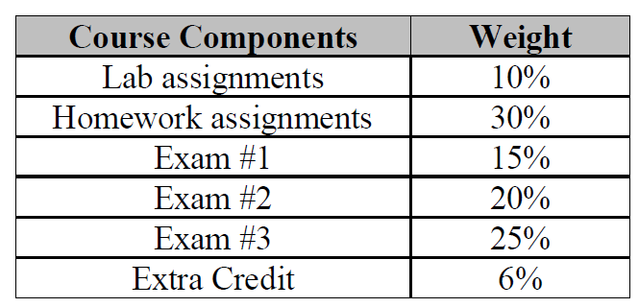
How will you be graded?

Slide 11

How hard is the course?
Difficulty
Up to week 6 the course is not terrible.
Learning basic C.
Time
Week 0
Week 6

Slide 12

Difficulty
After week 5-6 the course is extremely extremely hard. Why?
Time
Week 0
Week 6

Slide 13
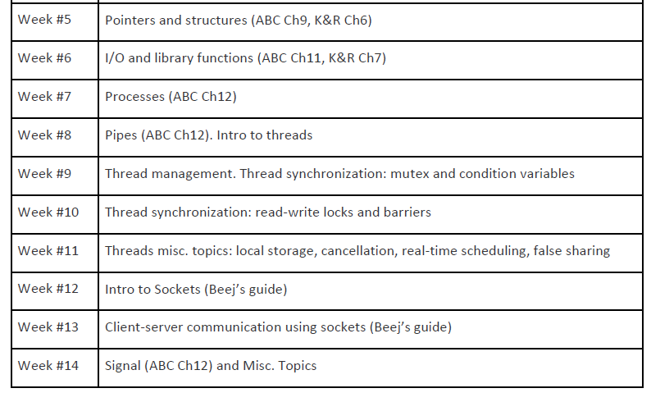
After week 5-6 the course is extremely extremely hard. Why?

Slide 14
How can you do well in the course?
Start coding assignments EARLY.
When you struggle, get help. Multiple types of help offered!
TA Office Hours
Discord Server
Help during/after lecture

Slide 15
1. For Homework/Lab Help: TA Office Hours
TBD: HuskyCT will have a document listing all TA office hours which will be uploaded by Friday Jan 19th 2024

Slide 16

2. For Homework/Lab Help: Discord Server
Link coming soon!

Slide 17
Other Announcements
There is a lab 0 due this week!
Please make sure you can log into the virtual machine and do the lab.
Course Questions?

Slide 18

The C Language
C is a general-purpose programming language that was originally designed by Dennis Ritchie of Bell Laboratories and implemented there in 1972.
It was first used as the systems language for the UNIX operating system.
Is CSE 3100 just a course to learn a “dead” language from the 70s???

Slide 19
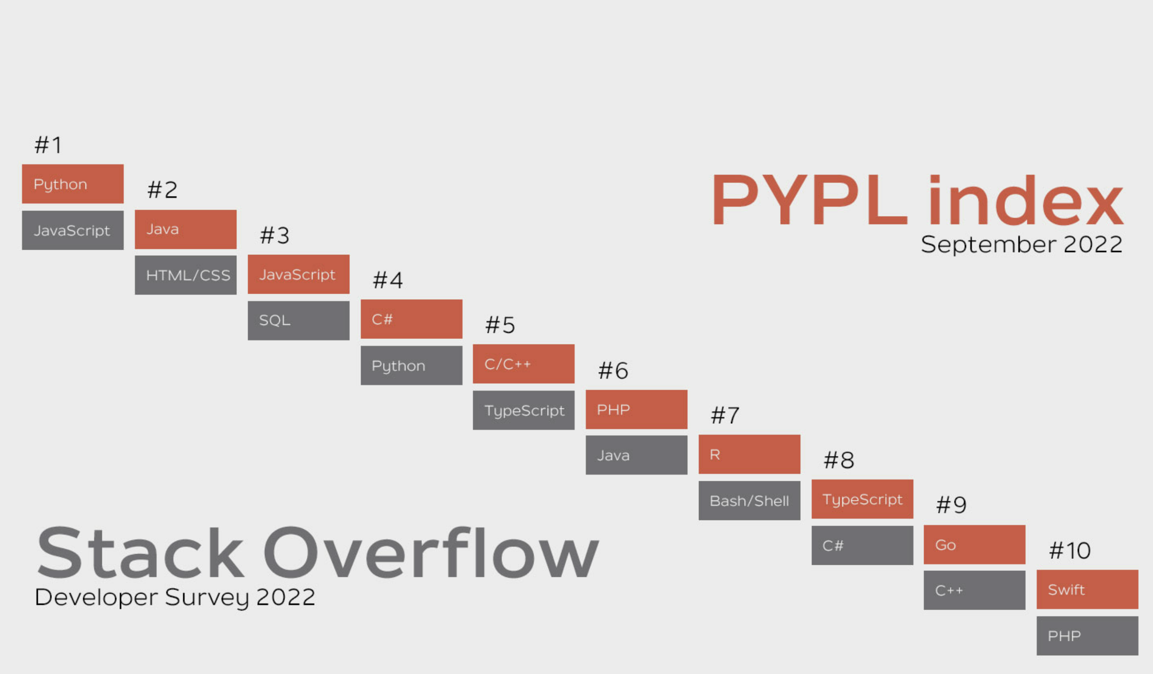
Most popular programming languages 2022
(https://www.stackscale.com/blog/most-popular-programming-languages/)

Slide 20
C Design Principles 1
C should be…
Simple
Easy to compile
Typed (as in we define the data types for variables)
Support low-level memory access
Ideal for embedded controller, OS, …
Yet…
C is powerful
C is fast

Slide 21
C Design Principles 2
C is a purely procedural language
No object-orientation whatsoever
Central Dogma
Object of interest: Computations
Main abstraction tool: Procedures/functions
Caller / Callee
Abstracts away “How things are done”
Programming means
Organizing processes as procedures
Composing processes through procedure calls
Simple English:
Write the code with functions.

Slide 22
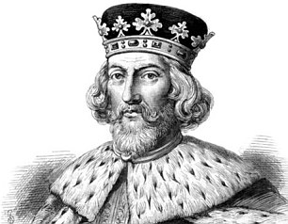
Procedural Programming in C
Generates very efficient code.
Exposes as many low-level details you wish to see.
Provides full control over memory management (no Garbage Collection!)
The Programmer is fully in charge.
Pictured: How it should feel to program in C.

Slide 23
What do we need to program in C?
Use text editor to edit source files
Use compiler to generate .o files
Use linker to link multiple .o files into executables
Text editor
Source files
.h .c
Compiler
Object files
.o
Linker
Executable

Slide 24
Example C Code
#include <stdio.h>
/* comments */
// single line comments
int main(void)
{
printf("Hello, world!\n");
return 0;
}

Slide 25
Comments in C
#include <stdio.h>
/* comments */
// single line comments
int main(void)
{
printf("Hello, world!\n");
return 0;
}
The compiler ignores everything between “/*” and “*/”
Comments are meant to be human readable!
Comments can be multi-line
Cannot be nested
Everything starting from "//" is ignored in a line

Slide 26
The ‘main’ function in C
A special function that defines the entry point for the program.
This is where the Operating System transfers control once the program starts.
void indicates no arguments
int before 'main' indicates the main function returns an integer.
#include <stdio.h>
/* comments */
// single line comments
int main(void)
{
printf("Hello, world!\n");
return 0;
}

Slide 27
printf in C
#include <stdio.h>
/* comments */
// single line comments
int main(void)
{
printf("Hello, world!\n");
return 0;
}
What is ‘printf’ ?
A C library function to print on the standard output for a process.
It takes a string as the argument
Between double quotations, like "This is a string."
‘\n’ is a newline character

Slide 28
Why do we ‘return’ anything from main() ?
#include <stdio.h>
/* comments */
// single line comments
int main(void)
{
printf("Hello, world!\n");
return 0;
}
When the process terminates, it can tell the OS how things went.
This is the way to report back.
Returning 0 means ‘everything went according to plan’.

Slide 29
What’s up with #include ?
It “imports” a header file.
What is a header file?
A file which contains C function declarations and macros to be shared between several source files.
What is a macro?
A macro is a fragment of code which has been given a name.
#include <stdio.h>
/* comments */
// single line comments
int main(void)
{
printf("Hello, world!\n");
return 0;
}
Info Source: https://gcc.gnu.org/onlinedocs/cpp/Macros.html#Macros

Slide 30
Compiling and Executing a C Program
hello.c program
What is cc doing really ?
Three steps
preprocesses hello.c
compiles hello.c to hello.o
links hello.o with libc
writes executable file a.out
You can and often will separate those steps!
The name of the executable can be changed
a.out is the default
./ indicates a.out in the current directory
Otherwise the OS searches directories in 'PATH'
#include <stdio.h>
int main(void)
{
printf("Hello world!\n");
return 0;
}
Terminal
$ cc hello.c
$ ./a.out

Slide 31

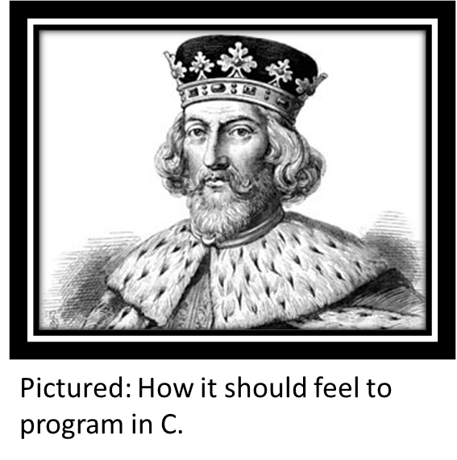
Lecture Conclusions
C is a low level but powerful programming language.
We’ll start with basic syntax and programming and will progress to more advance concepts like processes.
The course is very challenging so follow along closely and seek help when needed at office hours.
Week 1
Week 6

Slide 32
Figure Sources
https://media.pitchfork.com/photos/626be39b8eeb4ac0c1275b4e/master/w_1280%2Cc_limit/Future-I-Never-Liked-You-2022.jpeg
https://i.ytimg.com/vi/O1hCLBTD5RM/maxresdefault.jpg
https://1000logos.net/wp-content/uploads/2016/10/apple-emblem.jpg
https://preview.redd.it/xpcv28tuztqz.png?auto=webp&s=d27bf66316763d9a0cf420f68d34287df7992c7e
http://www.extremetech.com/wp-content/uploads/2012/02/CPU-Scaling.jpg
https://i.imgflip.com/5q88rn.png
https://en.wikipedia.org/wiki/Scheme_(programming_language)
https://images.emojiterra.com/google/android-11/512px/1f631.png
https://alanzeichick.com/wp-content/uploads/king3.jpg

